Slide 1

Vigenere Cipher
MACUNO
PATRIARCA
SAYSON
BALANDRA CADIENTE
MARIANO
MENDOZA
DEPACAQUIBO

Slide 2
Background
Blaise de Vigenère (1523–1596) was a French diplomat and spy who significantly advanced the field of cryptography. He is renowned for popularizing the Vigenère cipher, a sophisticated encryption method introduced in the late 16th century. This cipher encrypts text using a series of Caesar ciphers based on a keyword, providing enhanced security over simpler substitution ciphers through its use of a repeating key.
Although similar ciphers existed before Vigenère's time, his detailed explanation in his 1586 treatise, "Traité des Chiffres," helped solidify the cipher's place in cryptographic history. Vigenère's work not only improved the security of communication during his era but also influenced the development of future cryptographic techniques.

Slide 3
Vigenere Cipher
Vigenère ciphertext is a combination of a Caesar shift combined with a keyword.
The Vigenère cipher uses a keyword to encode a message. Each letter of the keyword determines how many positions the corresponding letter of the plaintext is shifted in the alphabet.
To perform the encryption and decryption, a Vigenère square or tableau is used. This is a grid where each row is a Caesar cipher shift of the alphabet. The row you use is determined by the letter of the keyword.

Slide 4
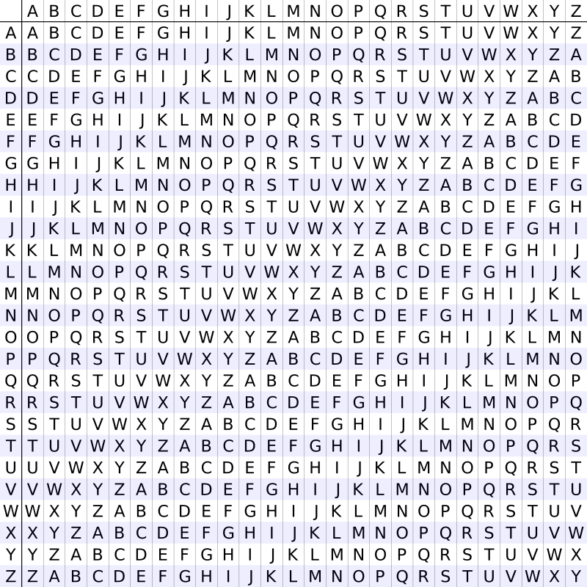
Vigenère square or Vigenère table
Also known as the tabula recta, can be used for encryption and decryption. Tabula recta uses a letter square with the 26 letters of the alphabet followed by 26 rows of additional letters.

Slide 5
How it works:
Keyword Selection: Choose a keyword that will be used to encrypt the message. This keyword should be repeated as many times as necessary to match the length of the plaintext.
Encryption Process:
Align the keyword with the plaintext.
For each letter in the plaintext, shift it according to the corresponding letter in the keyword. For example, if the keyword letter is 'B' (which is the second letter of the alphabet), shift the plaintext letter by 1 position (since 'A' is 0, 'B' is 1, etc.).
Decryption Process:
Align the keyword with the ciphertext.
For each letter in the ciphertext, shift it back according to the corresponding letter in the keyword to retrieve the original plaintext.

Slide 6
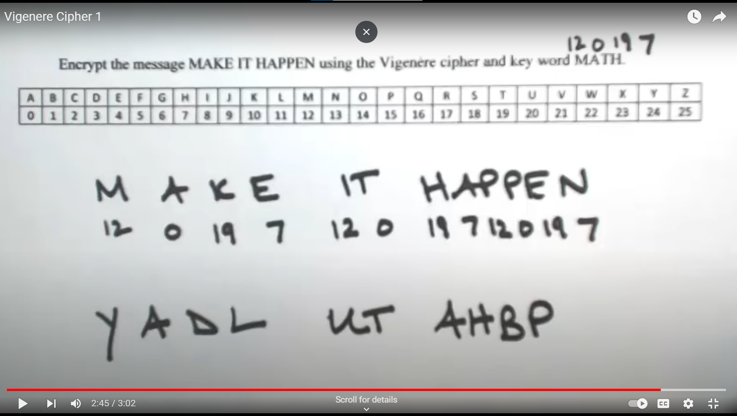
Example
Here's an example:
Keyword: KEY Message: ATTACKATDAWN Encrypted message: KXRKGIKXBKAL
Here's how the encryption works:

Slide 7
Table Method
Plaintext: THE SUN AND THE MAN IN THE MOON KEY: KING
THE SUN AND THE MAN IN THE MOON KIN GKI NGK ING KIN GK ING KING

Slide 8
Plaintext: THE SUN AND THE MAN IN THE MOON KEY: KING
THE SUN AND THE MAN IN THE MOON KIN GKI NGK ING KIN GK ING KING Encrypted: DPR YEV NTN BUK WIA OX BUK WWBT

Slide 9
Lets Try;
Try to solve the encryption “Hello World” KEY; Java (9, 0, 21, 0)
H E L L O W O R L D
16 4 32 11 23 22 35 17 20 3
Q E G L X W J R U D

Slide 10
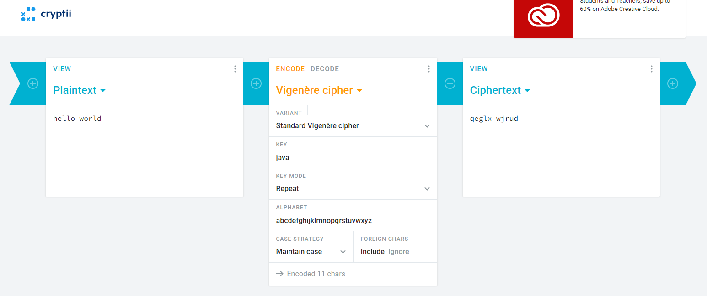

Slide 11
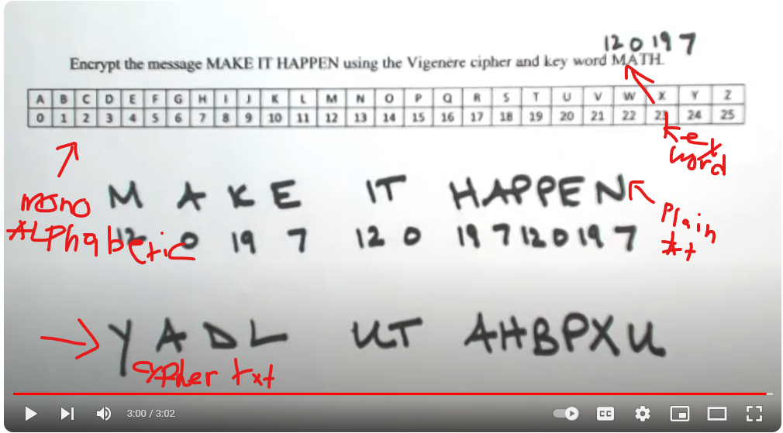
Vigenère Cipher
Vigenère cipher, type of substitution cipher used for data encryption in which the original plaintext structure is somewhat concealed in the ciphertext by using several different monoalphabetic substitution ciphers rather than just one; the code key specifies which particular substitution is to be employed for encrypting each plaintext symbol. Such resulting ciphers, known generically as polyalphabetics, have a long history of usage. The systems differ mainly in the way in which the key is used to choose among the collection of monoalphabetic substitution rules.
Plain Text: MAKE IT HAPPEN
Key Word: MATH
Cypher Text: YADL UT AHBPX

Slide 12
Solving Process Reference
https://youtu.be/E352JJ8xv48?feature=shared

